Slide 1
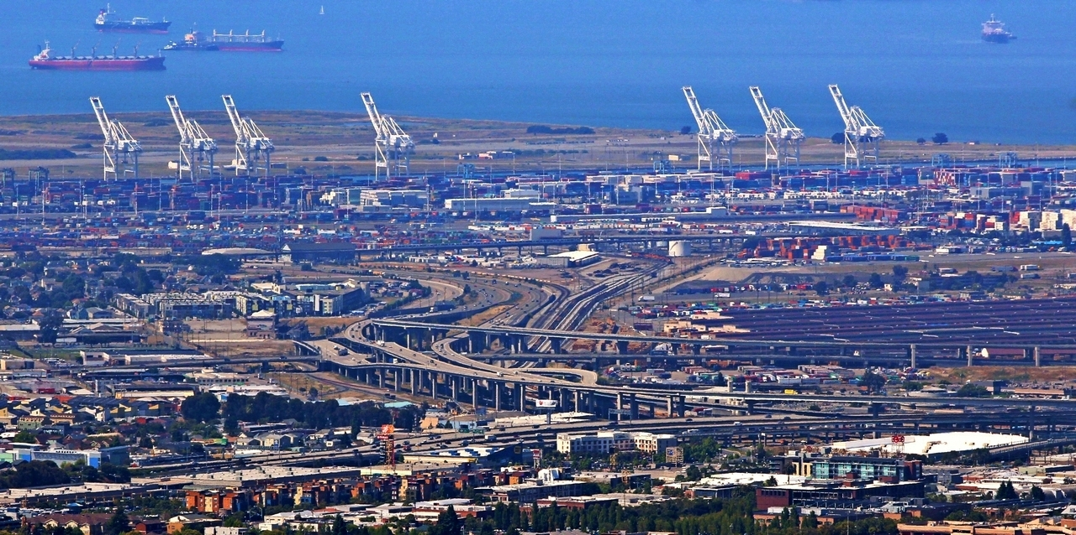
Beyond Notebooks: Software Design and Classes
Dr. Greg Erhardt
greg.erhardt@uky.edu CE599-002

Slide 2
Big Picture

Slide 3
The Goal
So far we have worked in notebooks. They are nice for their interactivity, but get messy as they get big.
Scripts are cleaner, so let’s look at how to set things up when writing code in scripts.

Slide 4
Procedural vs. Object-Oriented Programming
POP | OOP
In POP, program is divided into small parts called functions. | In OOP, program is divided into parts called objects.
POP does not have any proper way for hiding data so it is less secure. | OOP provides Data Hiding so provides more security.
Example of POP are : C, VB, FORTRAN, Pascal. | Example of OOP are : C++, JAVA, VB.NET, C#.NET.
https://www.slideshare.net/HarisBinZahid/procedural-vs-object-oriented-programming

Slide 5
Procedure Oriented Programming
It means “a set of procedures” which is a “set of subroutines” or a “set of functions“.
functions are called repeatedly in a program to execute tasks performed by them. For example, a program may involve collecting data from user (reading), performing some kind of calculations on the collected data (calculation), and finally displaying the result to the user when requested (printing). All the 3 tasks of reading, calculating and printing can be written in a program with the help of 3 different functions which performs these 3 different tasks.
https://www.slideshare.net/HarisBinZahid/procedural-vs-object-oriented-programming

Slide 6
Object Oriented Methodology is a certain process through which software can be developed. The goals of this methodology are to achieve Software Systems that are reliable, reusable, extensible; hence, more useful in the long run. The methodology achieves its goals by the help of a collection of objects that communicate by exchanging messages.
https://www.slideshare.net/HarisBinZahid/procedural-vs-object-oriented-programming

Slide 7
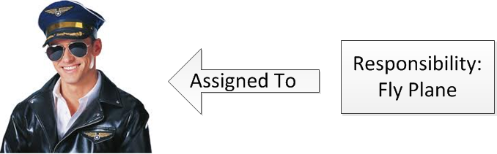
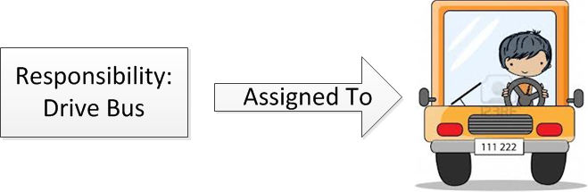
Objects Towards a higher level of abstraction
Hence, every object has 3 important features
1. Characteristics (e.g. Name, Designation, Job description etc.)
2. Responsibilities (e.g. drive bus, fly plane etc.) – these are assigned on the basis of the object’s characteristics – A manager object would have different responsibilities than a developer, since their job descriptions (a characteristic) would be different:
3. Relationships with other objects (explained in detail later) – in order to send requests/messages to each other, objects need to have some relationship/connection. E.g. A bus driver needs to have access/connection to a bus in order to drive it.
https://www.slideshare.net/HarisBinZahid/procedural-vs-object-oriented-programming
Notes:
Must follow the Required Content structure
Clear and concise purpose
Should fit into the overall training program
Determine level of training and adhere to it throughout
Beginner, Intermediate, Advanced
Introduce concepts in an easy to follow manner
Provide text and audio
Product trainings should include hands-on video examples

Slide 8
Classes
Exercise: What class/category do these objects belong to?
Pencils, erasers, pens, rulers, sharpeners?
Bananas, apples, oranges, peaches, grapes?
Alice, Bob, Mark, Fahd, Ali, Brian?
Guideline: A class usually represents a noun
https://www.slideshare.net/HarisBinZahid/procedural-vs-object-oriented-programming
Notes:
Possible Answers to the Exercises:
Stencils
Fruits
People/Humans/Names

Slide 9
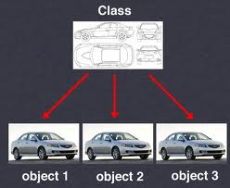
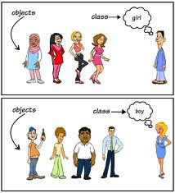
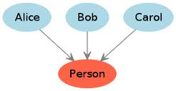
Classes vs. Objects some pictorial examples
https://www.slideshare.net/HarisBinZahid/procedural-vs-object-oriented-programming

Slide 10
A Simple Template
Road.py

Slide 11
Running at a command prompt
Running a script:
python <script_name>
i.e.
python build_road.py

Slide 12
Running at a command prompt
Execution starts at:
if __name__ == '__main__’:
Why is that at the end of the script?

Slide 13
Running at a command prompt
Passing command line arguments:
python <script_name> <arg1>
i.e.
python point1.py 2

Slide 14
Some Examples
DTA (Dynamic Traffic Assignment) Anyway
https://github.com/sfcta/dta
UrbanSim
https://github.com/UDST/urbansim
ActivitySim
https://github.com/ActivitySim/activitysim

Slide 15
Homework
1. Read (and understand) chapters 15, 16 and 17 of Think Python:
http://greenteapress.com/thinkpython/thinkpython.pdf
2. Do the exercise on the next page. You can test your solution in a notebook, but should implement the final solution in scripts.

Slide 16
Homework
__str__(self)
Create a class called car, with the attributes: color, location (x, y coordinates), and direction.
Write methods for: go(), turn_left(), and turn_right().
Add a print() method that prints the current attributes of the car.
Write a script to:
Create a yellow car. Move the yellow car forward two units, turn left, move forward one space.
Create a green car. Turn left. Move forward one space. Turn right. Move forward two spaces.
Print both cars.

